Slide 1
Best Practices for
Accessible
Social Media
Mindy Johnson | AEM Center & CAST
Director of Digital Communications & Outreach

Slide 2
My disability exists not because
I use a wheelchair, but because
the broader environment
isn't accessible.
Stella Young, Disability Rights Activist

Slide 3
Social Media Accessibility
WebAIM’s Screen Reader User Survey #7 (2019)

Slide 4








What’s Your Flavor?

Slide 5
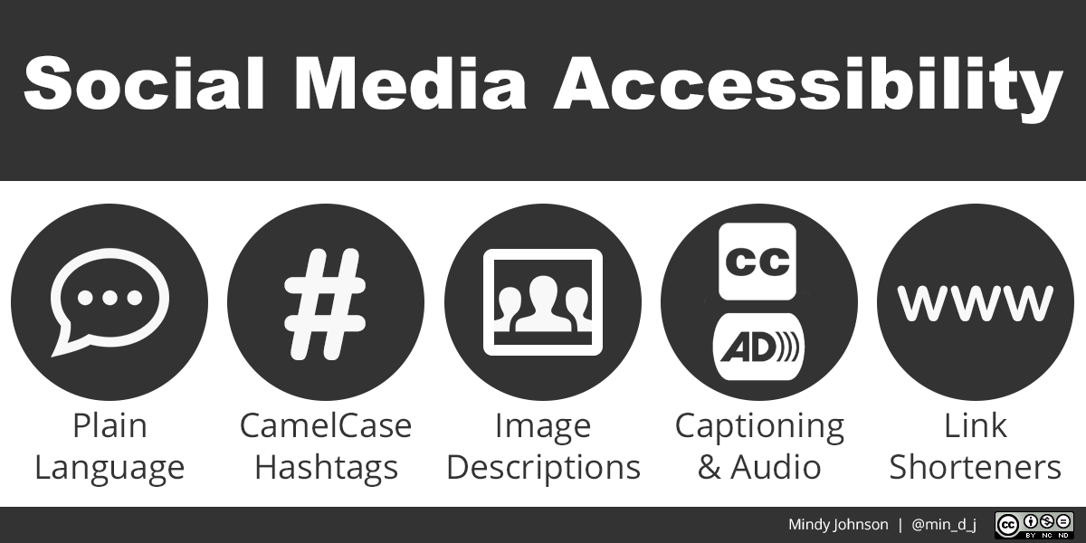

Slide 6

Plain Language
Avoid acronyms, abbreviations,
and jargon.

Slide 7
Plain Language: Example
Not plain language:
“It is imperative that our MTSS includes UDL at all levels of instructional support.”
Plain language:
“Universal Design for Learning isn’t just for students who struggle. It’s for everyone.”

Slide 8

CamelCase Hashtags
CamelCase
makes hashtags
easier to read.

Slide 9

What is CamelCase?
CamelCase

Slide 10
CamelCase: Examples
#notcamelcase
#themoreyouknow
#followfriday
#udlchat
#notsoeasytoread
#a11y
#aem4all
#CamelCase
#TheMoreYouKnow
#FollowFriday
#UDLchat
#SuperEasyToRead
#a11y or #A11y
#AEM4all or #AEM4All

Slide 11
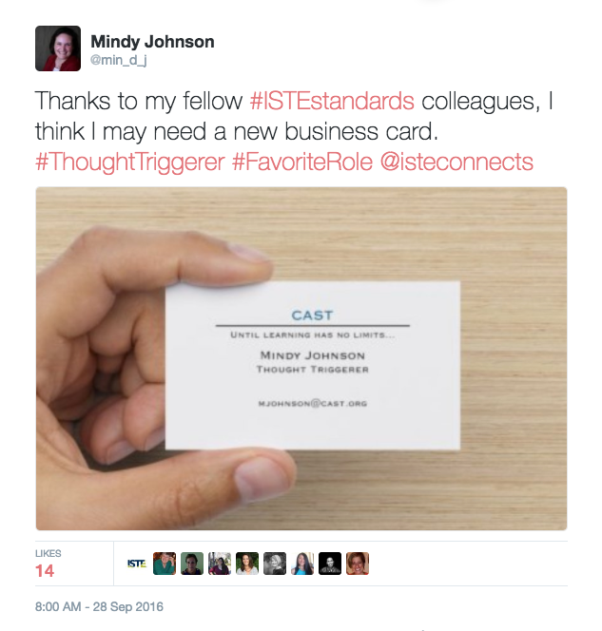
CamelCase: Example

Slide 12

Image Descriptions
Images without descriptions are like an unfinished story.

Slide 13
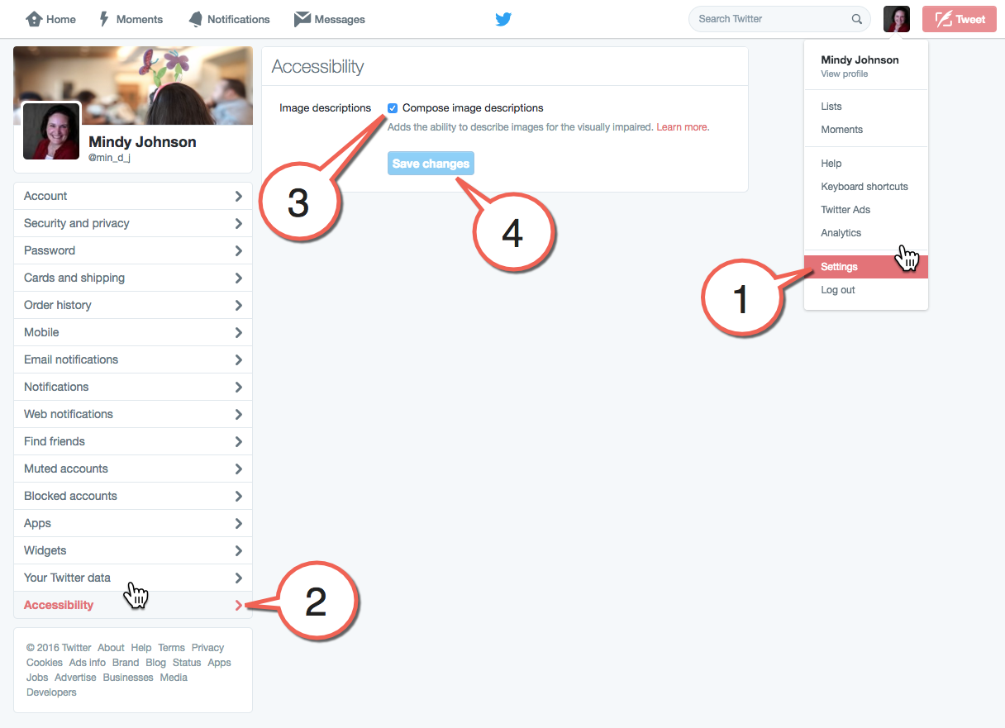
Image Descriptions: Twitter

Slide 14
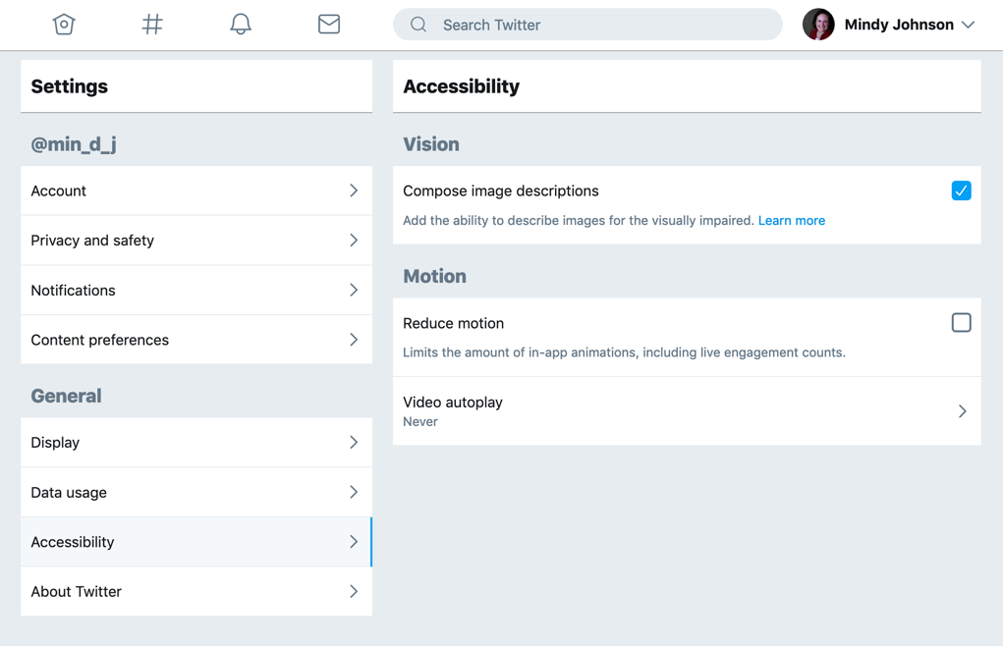
Image Descriptions: Twitter

Slide 15
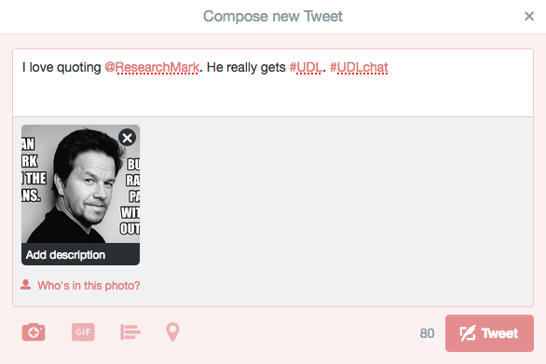
Image Descriptions: Twitter

Slide 16
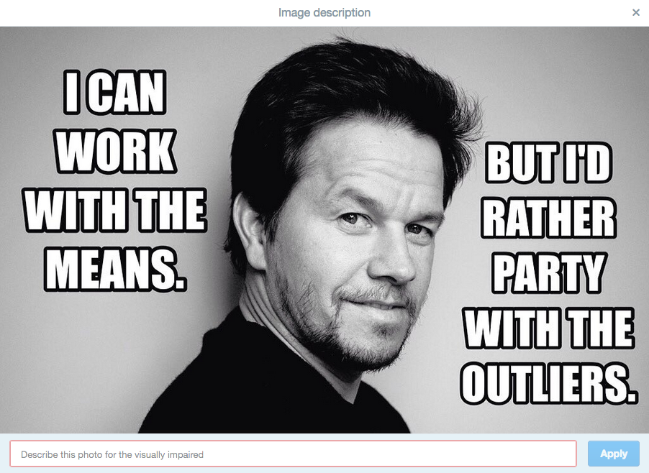
Image Descriptions: Twitter

Slide 17
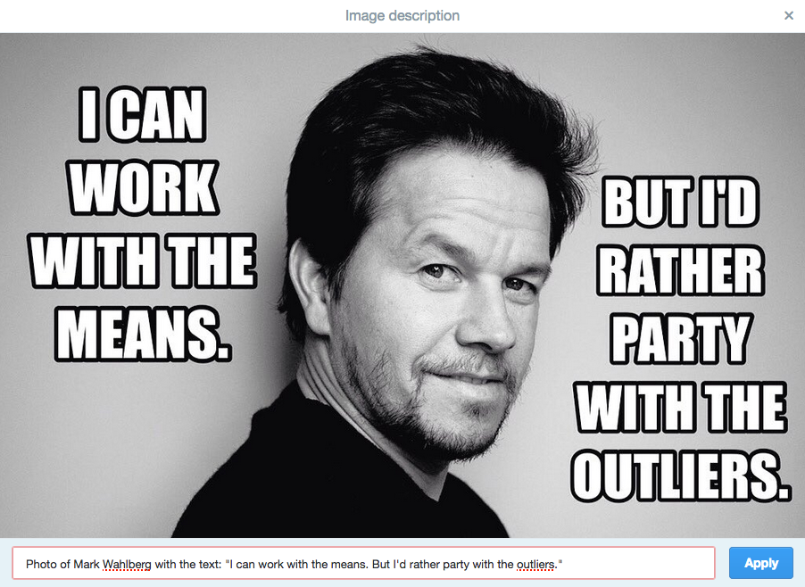
Image Descriptions: Twitter

Slide 18

Image Descriptions: Twitter

Slide 19
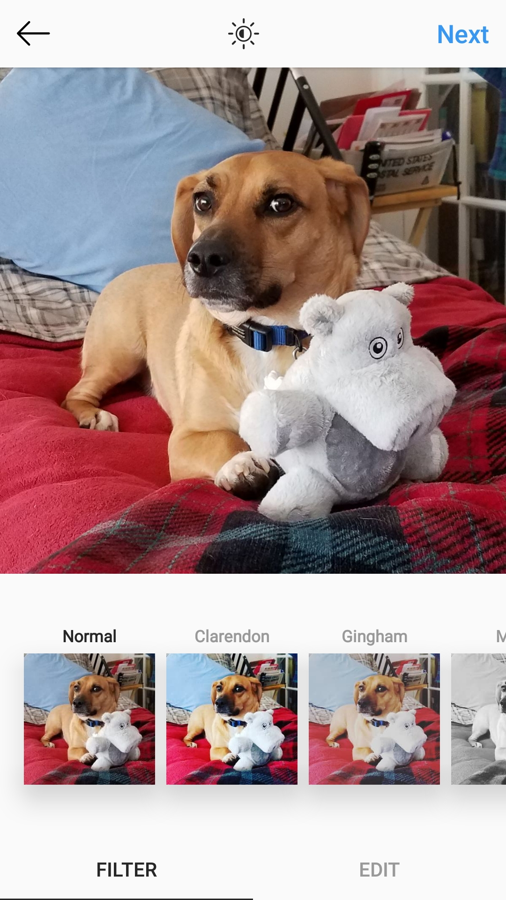
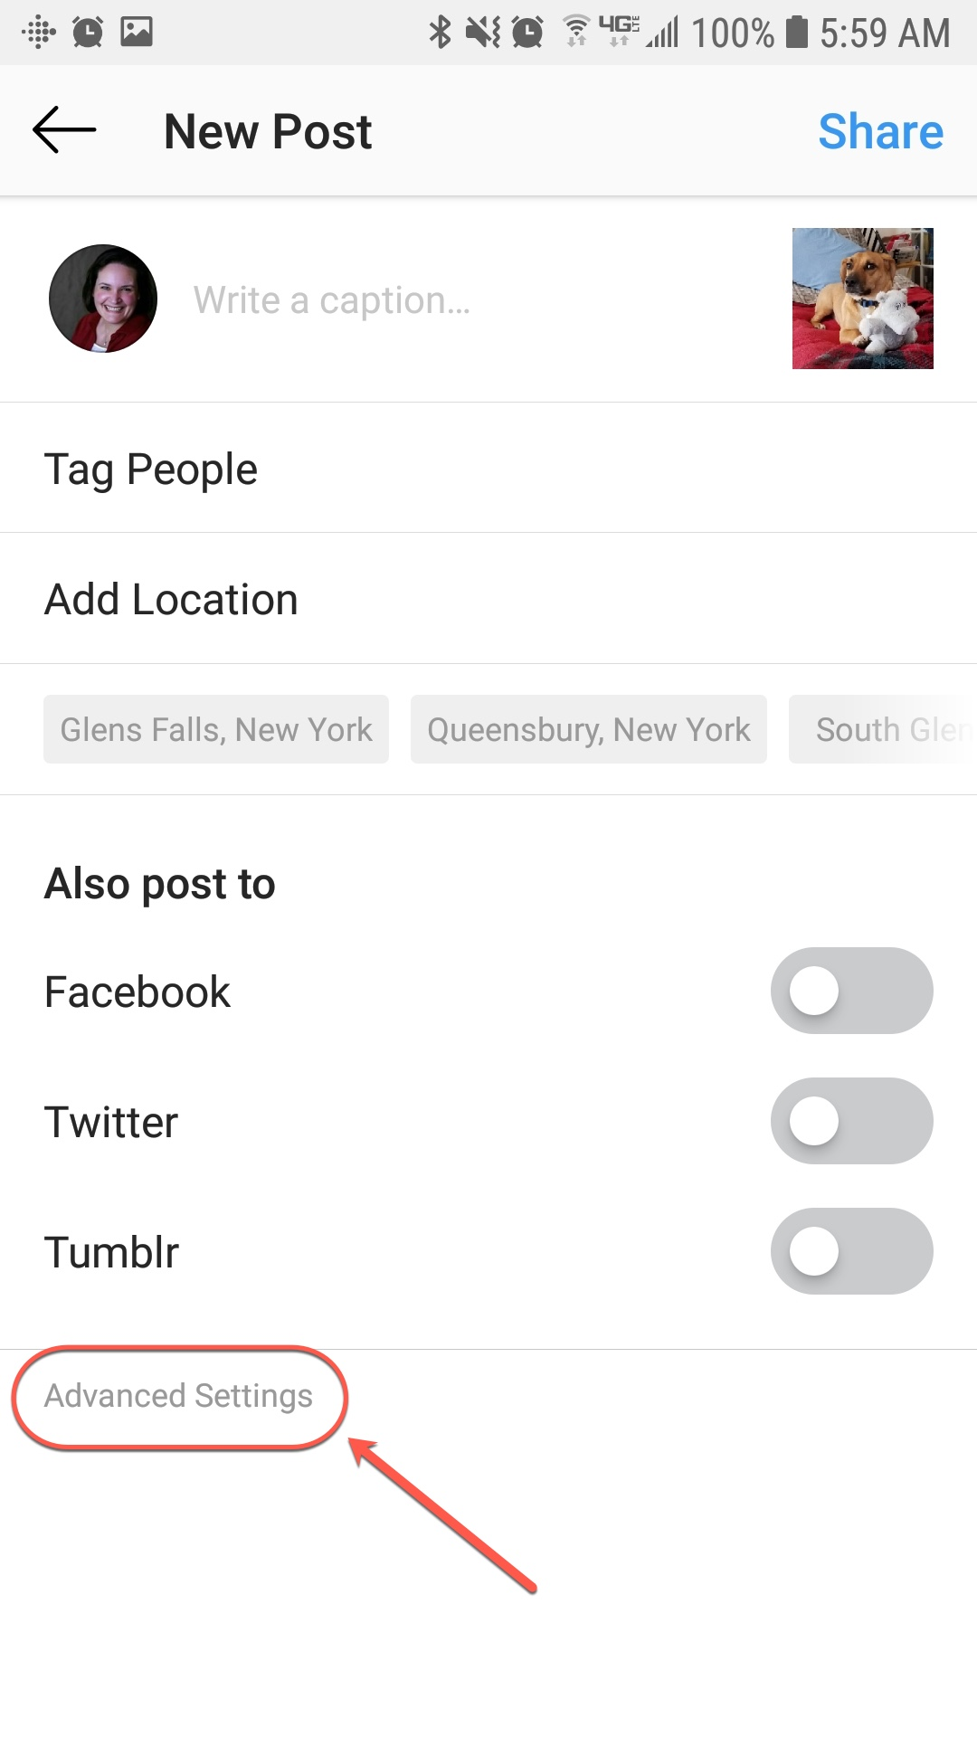
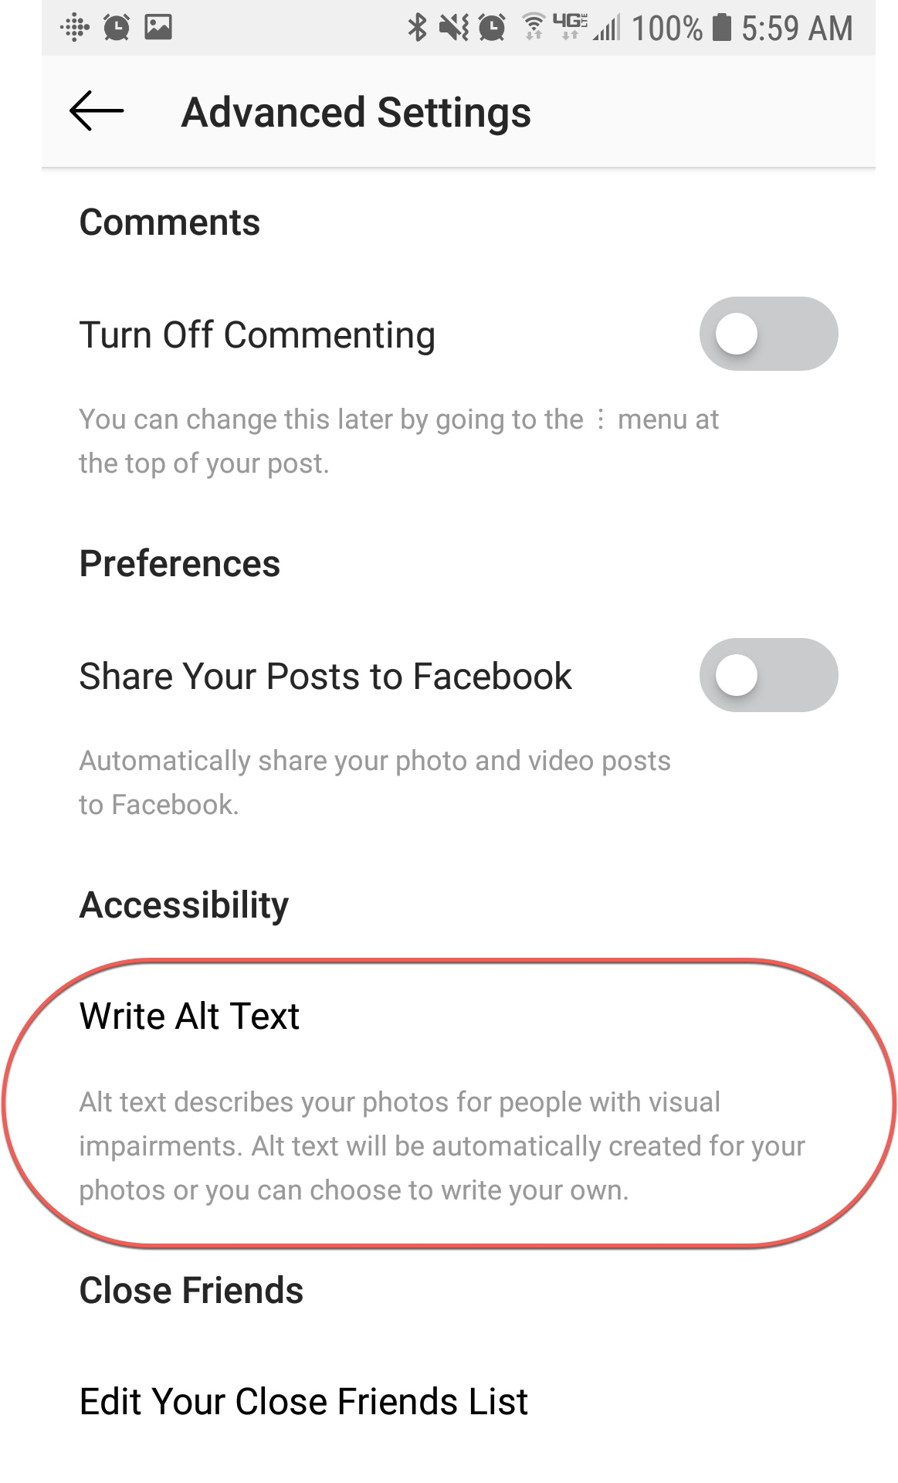
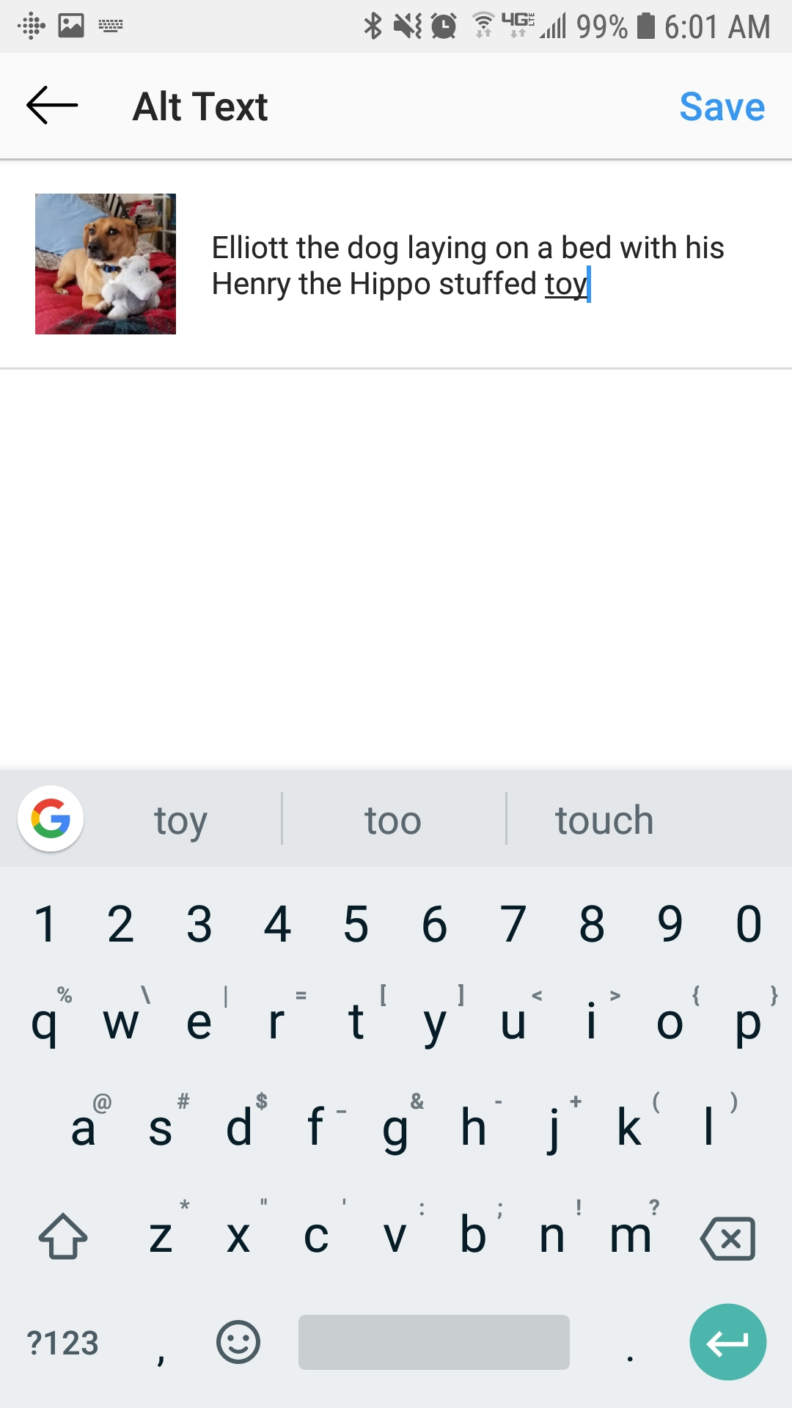
Image Descriptions: Instagram

Slide 20
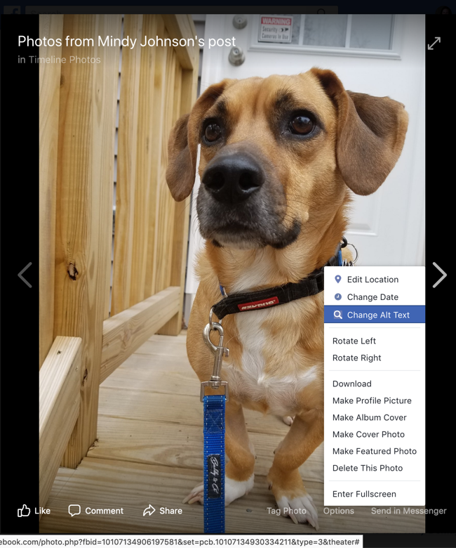
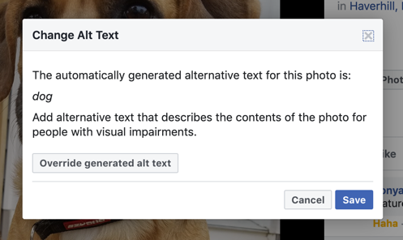
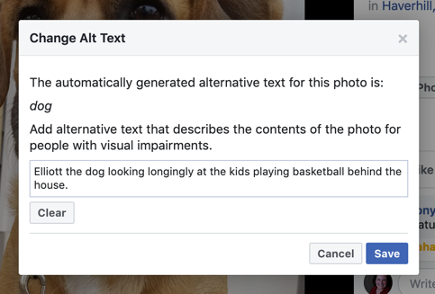
Image Descriptions: Facebook

Slide 21
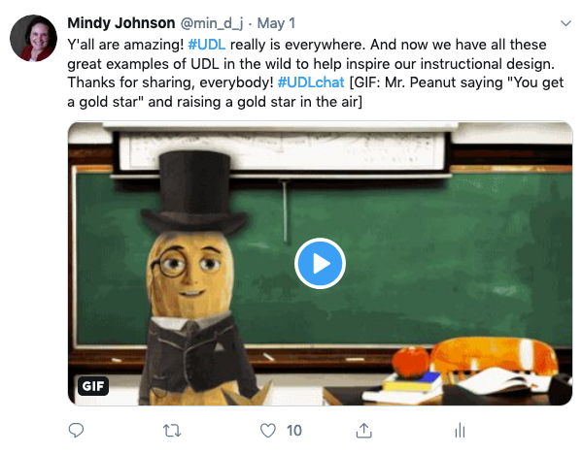
Image Descriptions: GIFs

Slide 22

Captioning & Audio
Transcribing and captioning videos is easier than ever. Audio descriptions are the next frontier.

Slide 23
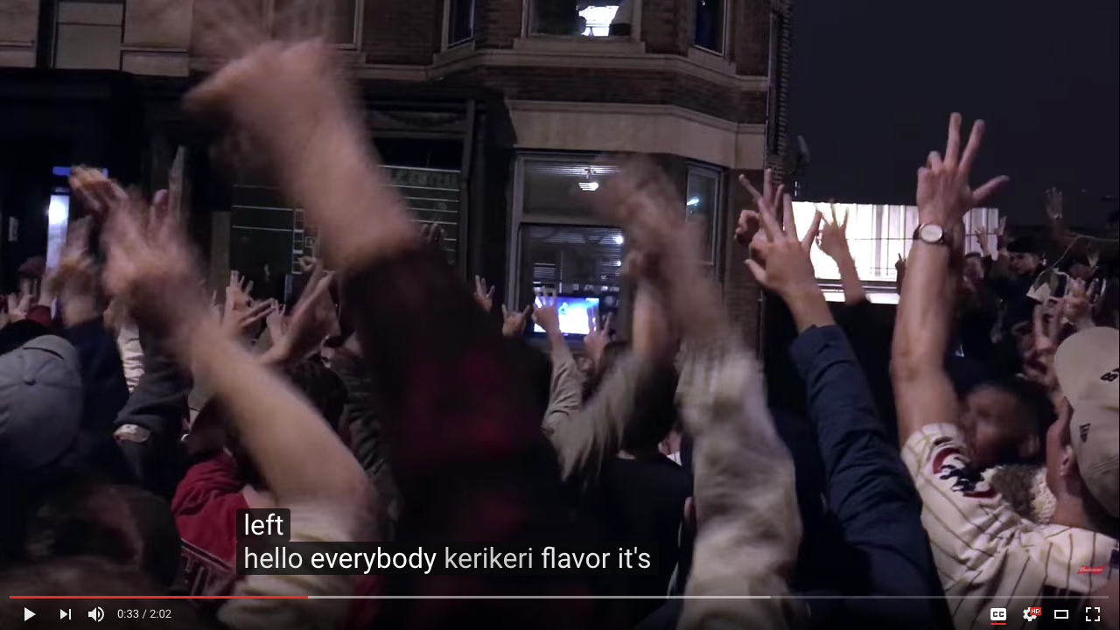
Captioned Video: Fail
What this should say:
”Hello again, everybody. Harry Caray in Cleveland.”

Slide 24
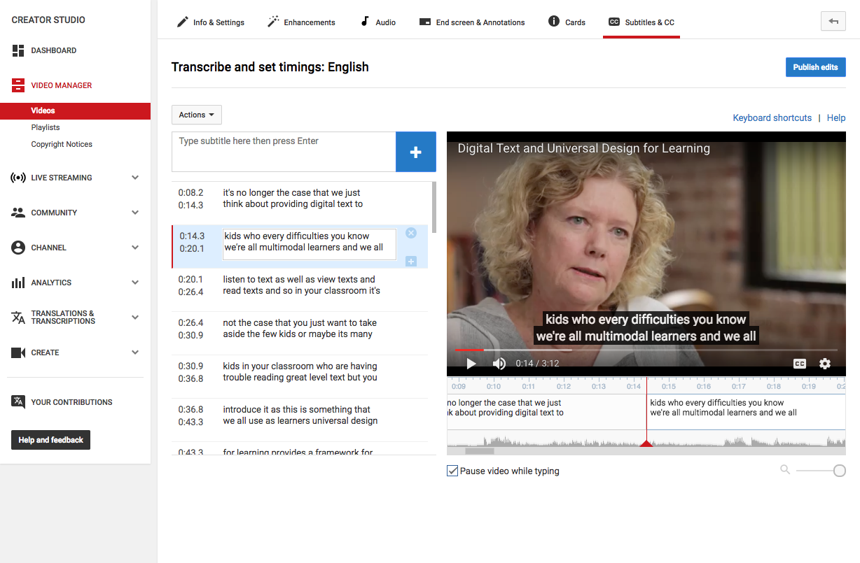
Captioned Video: Example

Slide 25
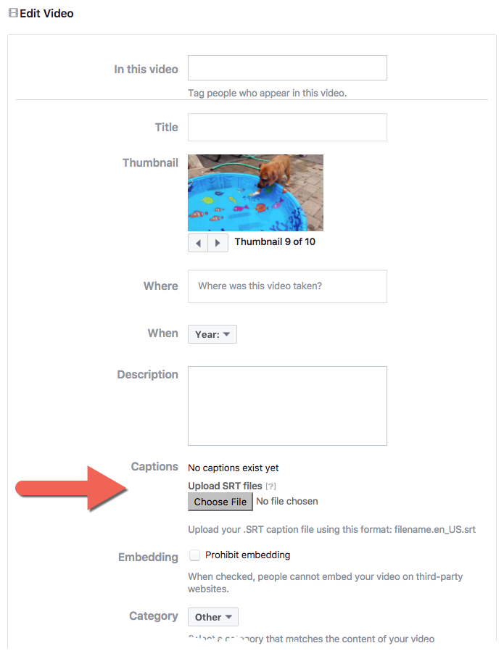
Captioned Video: Example

Slide 26

Captioned Video: Example

Slide 27
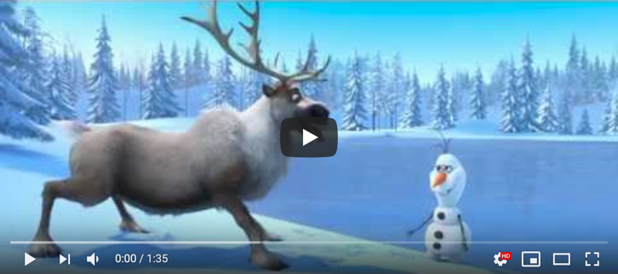
Audio Description: Example

Slide 28

Link Shorteners
Save characters.
Save lives.

Slide 29
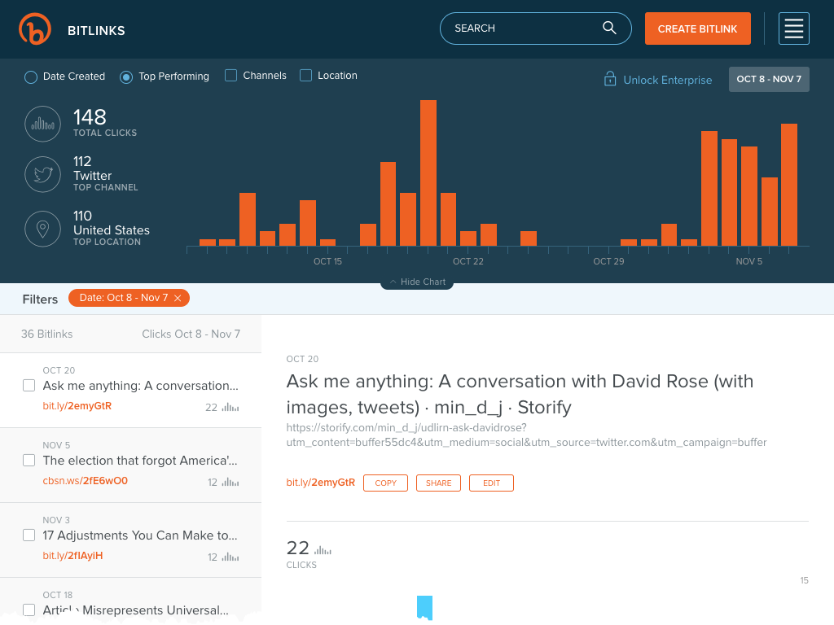
Link Shorteners: Resources
Bit.ly
TinyURL
Ow.ly

Slide 30

Link Shorteners: Example

Slide 31
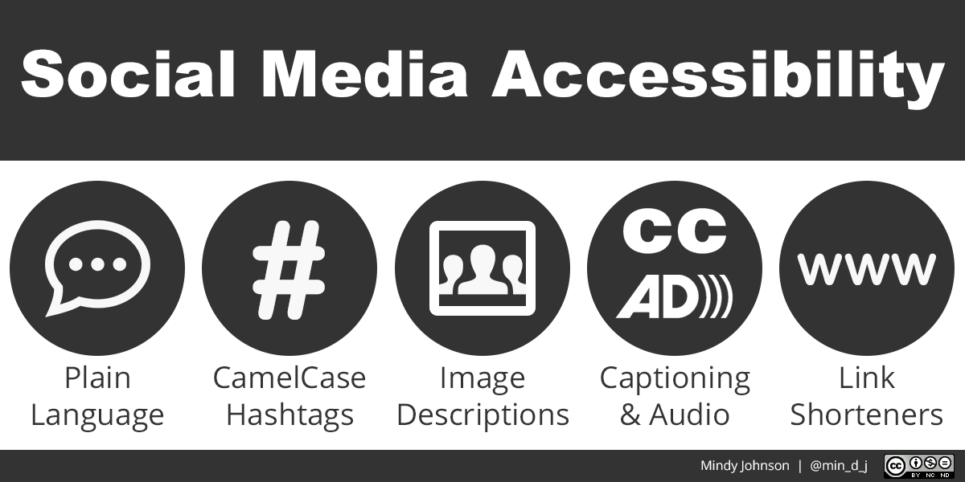
Putting It All Together

Slide 32
Questions
?

Slide 33
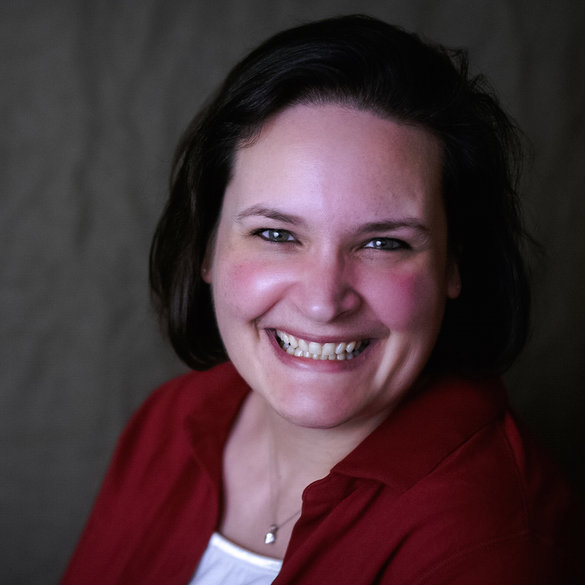
Thank you!
AEM Center
aem.cast.org
Digital Handout
bit.ly/aem-socialmedia
#UDLchat
1st & 3rd Wednesdays
9-9:30pm ET / 6-6:30pm PT
Mindy Johnson
mjohnson@cast.org

